Slide 1






Zeal IT Consultants
What is a Software Consultant?

Slide 2


A Brief Introduction
Senior Director of Engineering at Zeal:
Technical planning, leadership and client relations
Architecture and technical problem solving
Technical sales and project planning
25 years of professional software development experience with 7 total in consulting
Fun Career Highlights:
Written 4 programming languages
Lead a multinational in the development of their first ever cloud and mobile offerings
Contributed code to an RTOS used on the Mars Rover
Loves cats
https://www.linkedin.com/in/dlarsen393/

Slide 3
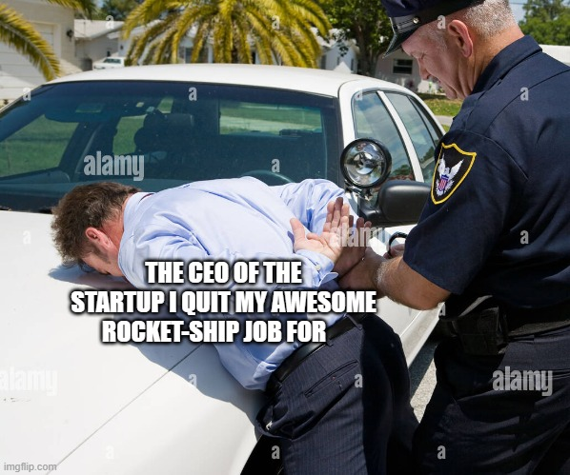
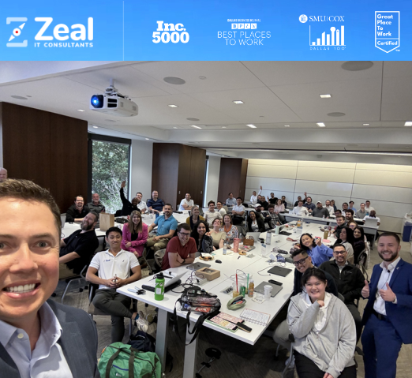
How I Started at Zeal
How it’s going
How it started…

Slide 4
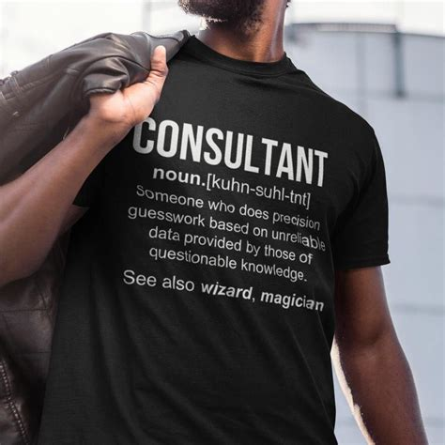
What is this Presentation About?
Consultants do the same sort of physical work that regular software engineers do, but more on top. You can summarize it as:
Developer + ??? = Consultant
In this presentation we’ll cover:
First, what does a “Developer” do all day? Is it just programming (spoiler alert: no)
What’s the secret sauce in the ‘???’
Finally, why would you want to be a consultant?

Slide 5



3 Types of Professional Developer
In-House Developers work directly for the company they provide services for. They gain great depth of knowledge with the technology and business problems of the company they work for
Contractors are often indistinguishable from In-House Developers, as they follow the same processes. They work for a different company on paper though, and often change gigs more often than an In-House Developer
Consultants get brought in when the existing approach is not working, must bring their own expertise and processes, and be relentlessly focused on delivery

Slide 6
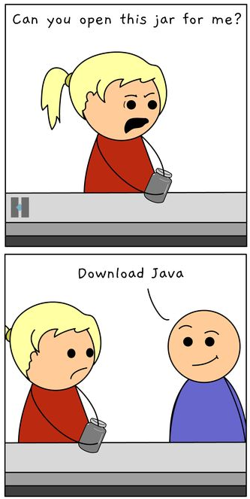
Programming is Only Part of It…
For ALL professional computer programmers of any type, there’s a lot more to the job than just one’s programming skills
Communication is the number one complement to a good developer. Do not wait to develop your presentation and business communication skills!
As we will examine in a bit, the type and amount of communication required is the key difference-maker between being an in-house developer/contractor and a consultant
Time organization, self motivation and business dynamics aer always important
There are satellite “technical” skills that are very important: estimation, work break down, debugging, training/mentoring, etc.

Slide 7
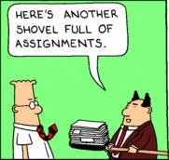
… there’s also paperwork! Yay!
The difference between coding your own projects for fun and coding professionally will usually have to do with “the business”. Many environments have an us-vs-them mentality between the technologists and business people
The touchpoint between these two camps is the software development process being used (Scrum, SAFE, Waterfall, etc.)
Organizations with a good working relationship between these two sides have very lightweight processes based on interactions and trust
Organizations with a bad working relationship here will favor high process and lots of formalized, ritual communication
Often the hardest part of a project is not the technical details or the hands-on-keyboard coding, but navigating these social interactions to make sure you’re building the right thing and telling people how it’s going

Slide 8
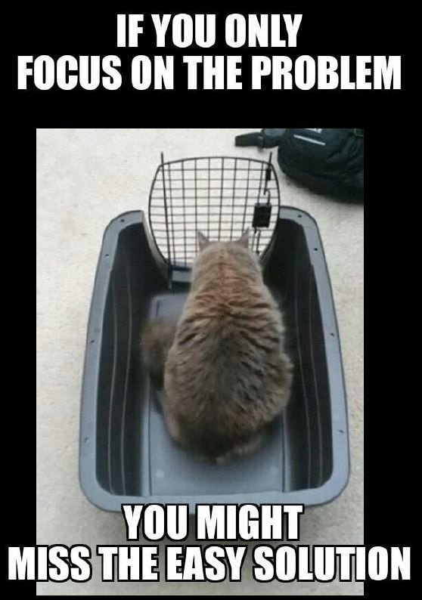
We Rescue Failing Software Projects
As Consultants, we rescue failing software projects. When the stuff we’ve just been talking about breaks down and stops producing enough business value for the time and money invested, consultants are brought in to right the ship
This doesn’t mean our clients are bad programmers, or bad business men, or incompetent or anything like that. These social systems and processes evolve over time, and it can be difficult or impossible to change them from within
Some examples:
How a client’s quest for accurate estimation led to nothing ever getting done (the 10% rule)
How to spend $1.5mm to root cause a <$10,000 outage
And then how not to do anything with the information
How to spend more than a million dollars on software without ever reaching the requirements gathering phase

Slide 9
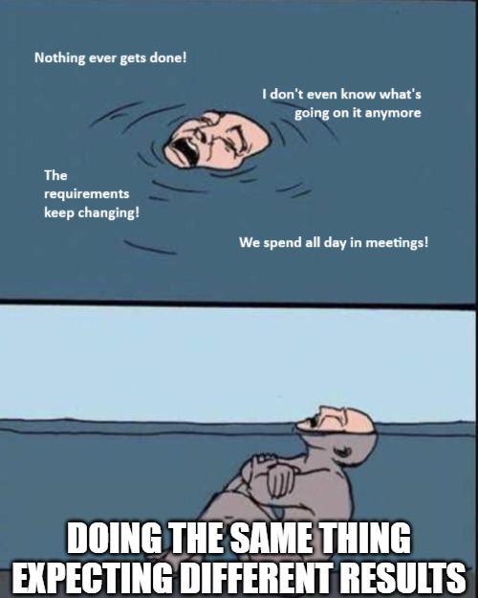
How do we do it?
We bring our own pods – lean, carefully composed teams that have their own process and working agreements
As outsiders we can challenge the existing process and stay above local politics
We cut out middle management. Everyone on the team has deliverables and works to achieve the goals and tech leadership interacts directly with Zeal business leadership
As a software company, we have better hiring and training processes and the ability to retain good developers through difficult project scenarios
We are perceived as (and strive to be) subject matter experts

Slide 10
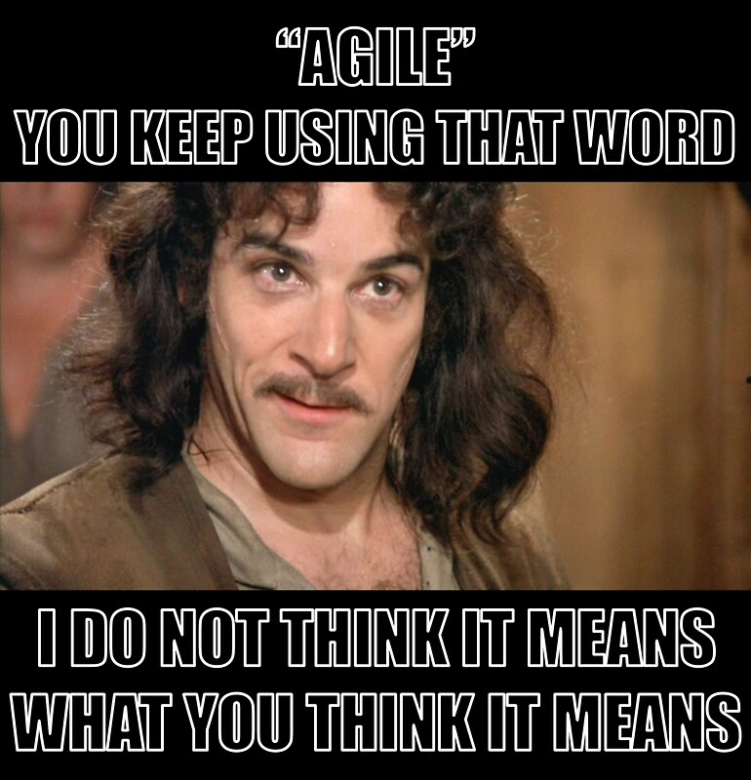
Agility is the Key
In practice, agile is the only working “methodology” for developing software. Other processes can work for project planning and management but for development itself agile is king.
The principles of Agile are:
Individuals and interactions over processes and tools
Working software over comprehensive documentation
Customer collaboration over contract negotiation
Responding to change over following a plan
Iterative is the approach to refining something, it is relevant for code of course, but also for requirements, processes, relationships… everything!

Slide 11
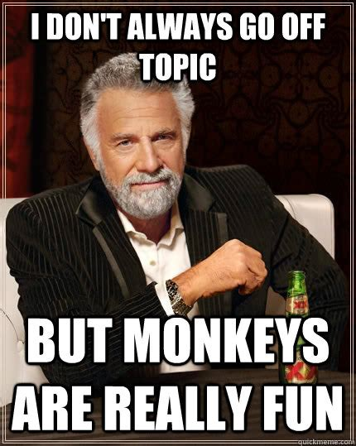
Okay, back on topic now
So let’s review. In brief…
Consultants are brought in when a project is going badly or is outside the comfort zone of the organization
Consultants cannot show up and provide “more of the same”, they have to bring their own, working process and teams
Consultants are subject matter experts and can shift long-held approaches and attitudes
If we can’t, we can leverage our functional process to deliver business value in spite of environmental challenges
Consultants have to be able to bridge the gap between the business and technologists with communication and more efficient process

Slide 12
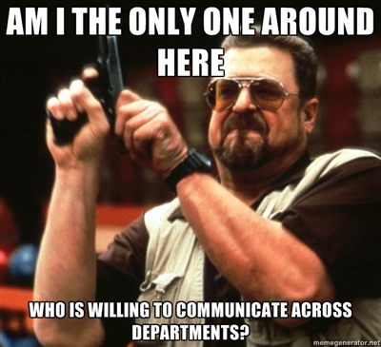
Bridging the Communication Gap
Because of the nature of their respective tasks, business and engineering speak two very different languages, and language drives thought, so in some ways they think differently
To have an effective technical communication you need: high accuracy, specific details, logical justification and fluency with the appropriate terminology
None of these things are of very high priority in a non-technical communication though… some of them are even counterproductive!
Most people naturally “project” the way their own mind works onto people around them
This is an effective shortcut that lets us function out in the world
But when people don’t live up to our expectations, problems emerge
“How dare you not act like the imaginary version of you I made up in my head!”

Slide 13
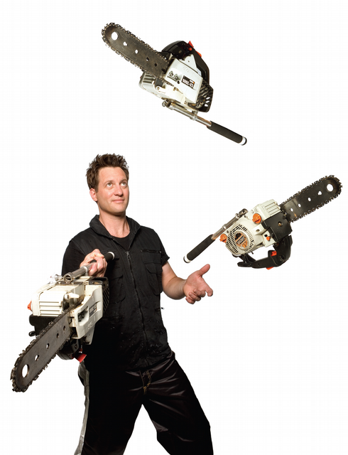
The Consultant Metagame
Besides the differences in mindset and day-to-day interactions, there are some higher level differences between consultants and the other kinds of developer as well:
You will experience many codebases and technologies. Consulting is like wearing heavy training weights for your professional development chops
You have two different stakeholders which must be handled differently (the client and Zeal)
You have to onboard quickly and efficiently while demonstrating business value
You may work multiple projects at the same time

Slide 14
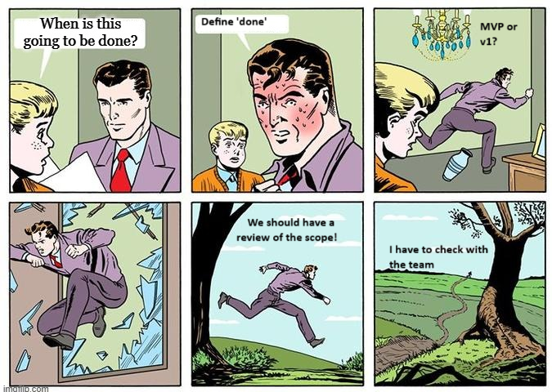
High Stakes Accountability
Our clients have many reasons to be very mindful and conscious of our business value delivery:
They have usually already spent money and not been successful
We are proposing a different approach
Consultants are not cheap
Because of this, consultants are always under a high pressure to deliver
Completing tickets, finishing story points… these things only matter insofar as they allow us to deliver business value to production. We can’t hide in process

Slide 15
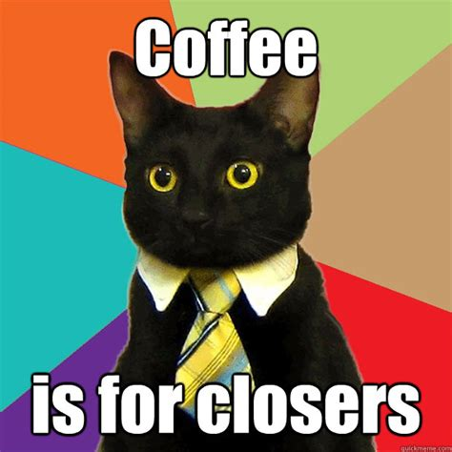
Sales is not a bad word
As a consultant, you are much closer to the sales pipeline than other kinds of developer. YOU are the product that Zeal sells to our clients
Your client interactions (even routine ones) have a sales component to them – your presentability, demeanor and what you have to say all impact our ability to retain the client and continue working on their projects
The best consultants embrace this. There is room in a consulting company for sound technologists who are less comfortable in this way, but their advancement opportunities are fewer and their ceiling is lower

Slide 16
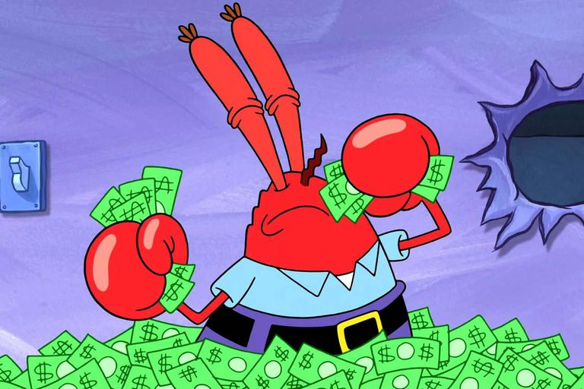
How Do Consultants Get Paid?
There are two main contract structures commonly-used in consulting:
Fixed Bid: We agree to deliver a certain thing for a certain amount of money
Time and Materials: We bill based on our hours worked and review project status regularly with the client to continue
At any point in the project, a consultant must be prepared to answer these questions:
Fixed Bid: Are we on track to finish by a particular date?
Time and Materials: What have we achieved so far/recently? What will achieve in the next time increment?

Slide 17
So, in Summary…
You have to be really good at programming – able to quickly acclimate to a new codebase, find the appropriate touchpoints and start making changes
You can’t be reliant on process to deliver – you have to think of the big picture, interact with your team intelligently and work towards the larger objective, not get caught up in the day-to-day paperwork
People trust you more, but have higher expectations of you
You have to be a business polyglot – you will learn the essentials of many different industries, styles of business and ways of storing business data and each project will have a unique set of challenges and requirements here
You have to constantly work to bridge the gap to the business: understand their real needs and wants; communicate your needs, expectations and progress; and keep them engaged with the development process throughout the cycle

Slide 18

Why Be a Regular Old Developer Then?
You like long-term stability and the ability to deep dive on a single thing (technology and business domain) for a long time
You are extremely attached to a single tech stack
You favor a particular industry or type of business and passionately want to work in that field
You don’t like starting new jobs and meeting new groups of people and enterprises
You want a job that becomes easier over time as you acclimate to it and that you can settle into

Slide 19
Do You Want to be a Software Consultant?
If you want to level up your programming quickly
New challenges excite you and keep you engaged in your work. You want to continue to grow as you work
Doing the same thing for a long time seems boring or limiting
You’re a solid communicator, or want to become one. You think customer service is an important part of a technical job
You want to learn how to do it the right way
You want to work for a software company with a software culture but still explore other business domains

Slide 20
Zeal IT Consultants
Whatever you do,
do it with Zeal.

